Slide 1
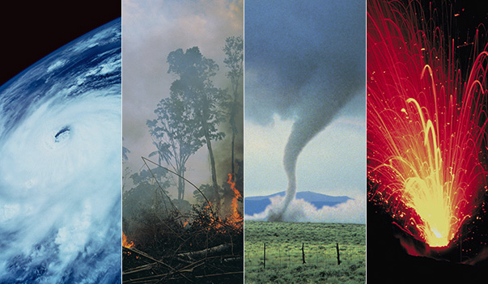
Impact of Natural Disasters
by Jaya Sahithi, Pujika Kumar, Andy Liu, Gaopo Huang, Jiawei Zheng (group 2)
Notes:
Hi everyone, we are group 2 and in our project we have analysed the natural disasters occurrence and their impact on us.

Slide 2
Motivation and objective
Analysis of Natural disasters
Impact in terms of death and damages
Trends and changes over time
Any effect on the awareness of climate change
Notes:
Our primary motivation was to analyse the natural disasters to find if their occurrence or the deaths caused by them have stirred up any awareness about the climate change. Along the way, we have tried to draw important insights about the trends of natural disasters, and their impact on human lives.

Slide 3
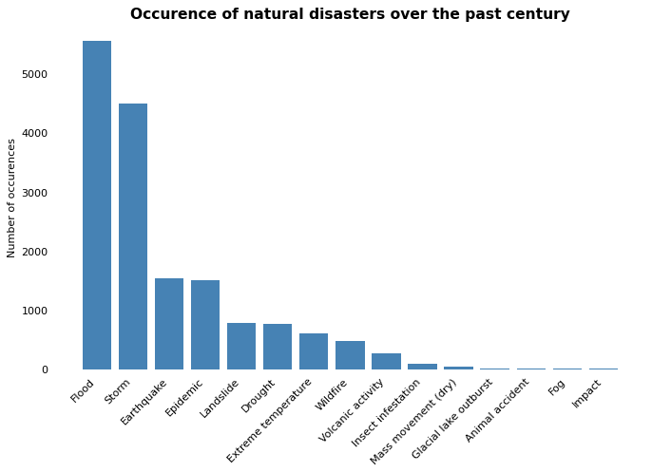
Datasets used in the analysis
Total Deaths
Disaster Type
Location
Time
Total Damage
Climate change Television News
GDP
Notes:
The datasets that we have used in the analysis are the EMDAT natural disasters dataset over the past century, the news coverage dataset specific to climate change and the country-wise GDP dataset.

Slide 4
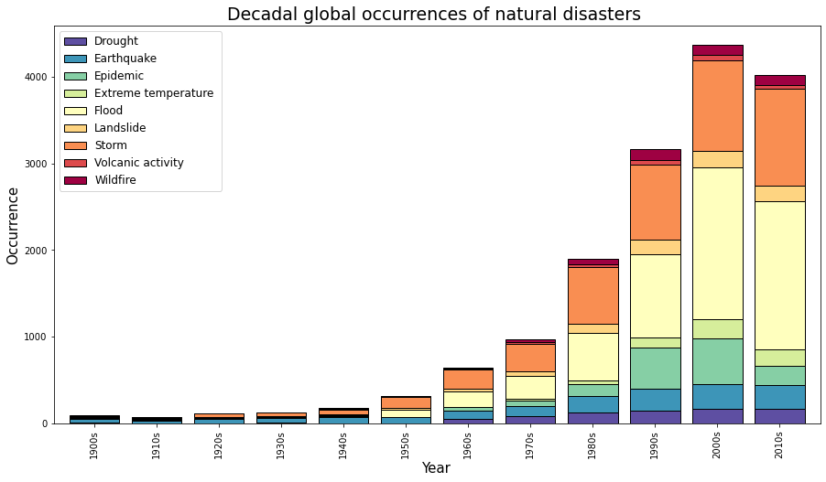
The occurrence of disasters increased over time
Notes:
In our first plot , we show the occurrence of disasters over time. we can see that the natural disasters occurrence has increased manifold just in the past 100 years. And we can also see that that floods and storm have consistently been the most common disasters in the recent past

Slide 5
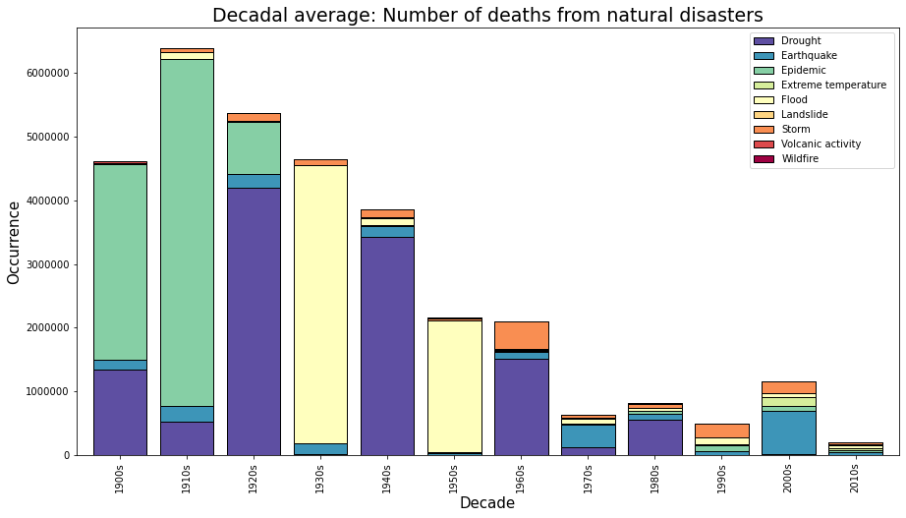
But the deaths caused by the disasters has decreased
Notes:
Next we explored the trend of deaths caused by these disasters. So even though the disaster frequency has increased, the deaths caused by these disasters have shown a significant decline.
We can see a better view in the next visualization

Slide 6
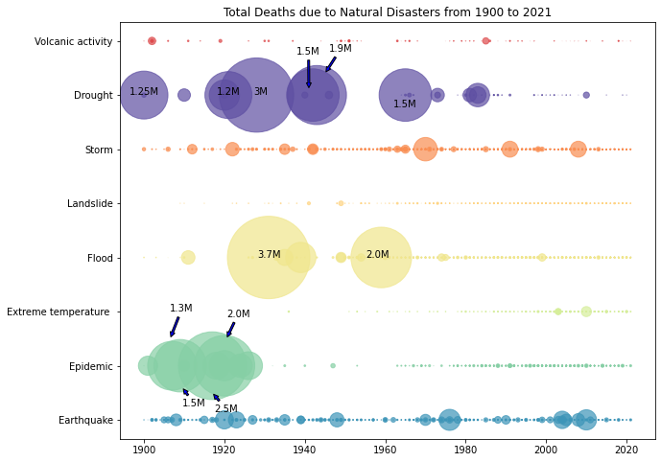
Historically, droughts and floods were the most fatal disaster events. Deaths from these events are now very low – the most deadly events today tend to be earthquakes.
Notes:
This graph plots the total number of deaths each year with respect to each disaster. The bubble area indicates the number of deaths.
As we can see In the early 20th century, the annual death toll from disasters was high, often reaching over one million per year. But in the recent decades, fewer than 20,000 people have died.
We also observe that there is a significant decline in deaths from almost all types of disaster with the exception of earthquakes and storm.
We clearly see that epidemic, droughts and floods were major contributors to the number of deaths till 1960s and it has shifted to earthquakes and storms in the recent past.
Another point to note is that this decline is even more impressive when we consider the rate of population growth over this period.

Slide 7
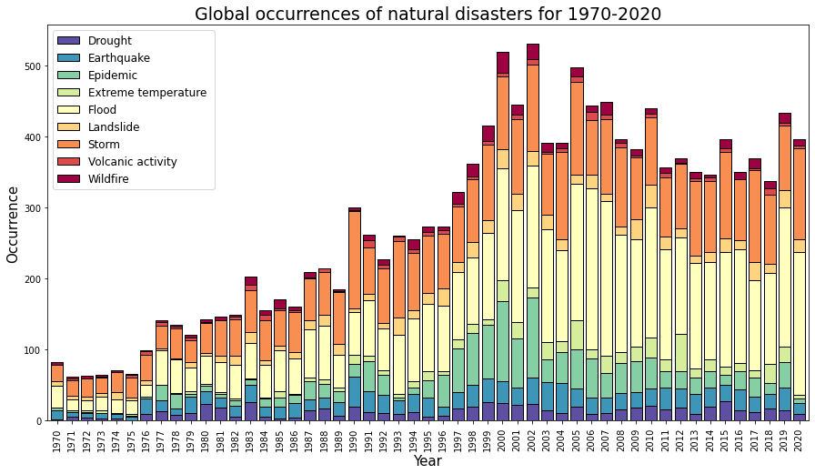
Trend in occurrence of disasters has increased significantly in the past 50 years
Flood has the most occurrence followed by storm.
Notes:
Now we move from the past century to the past 50 years to compare the trends in the deaths and the total damages

Slide 8
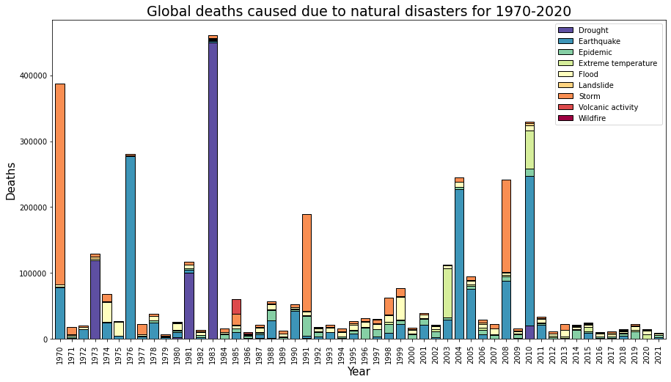
The deaths depended on the magnitude of the disaster
Or are there any other factors?
Notes:
What we see is that in many years, the number of deaths can be very low – often less than 10,000. But we also see the devastating impact of shock events which have caused a peak in deaths: for example the 1983 drought in Ethiopia; the 2004 Indian Ocean earthquake and tsunami; and the 2010 earthquake in Haiti. All of these events pushed annual global disasters deaths to over two hundred thousand (200,000).
Apart from the severity of events, are there any other factors for deaths?

Slide 9
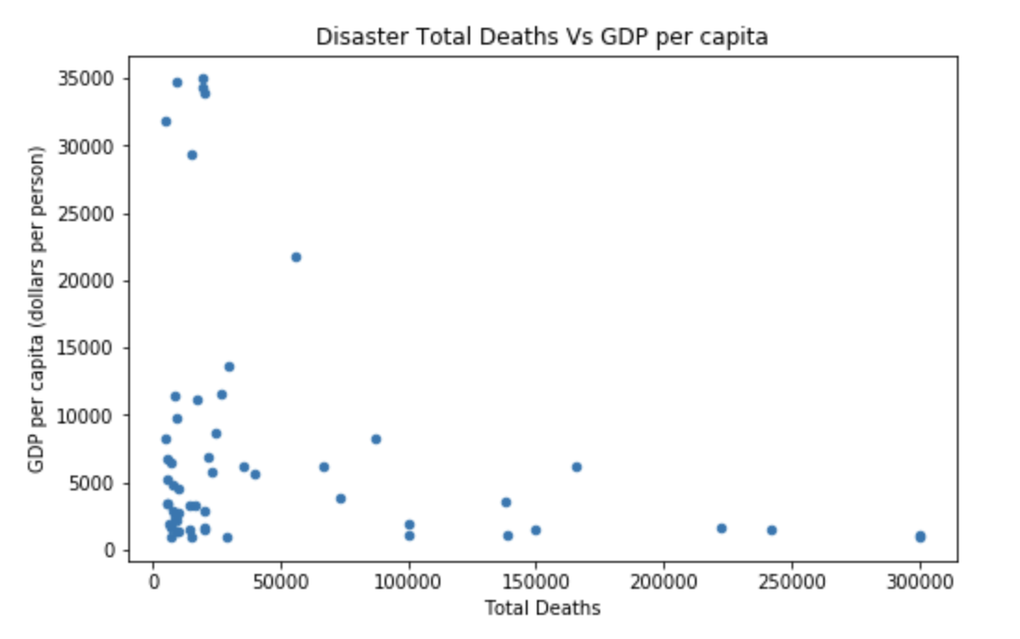
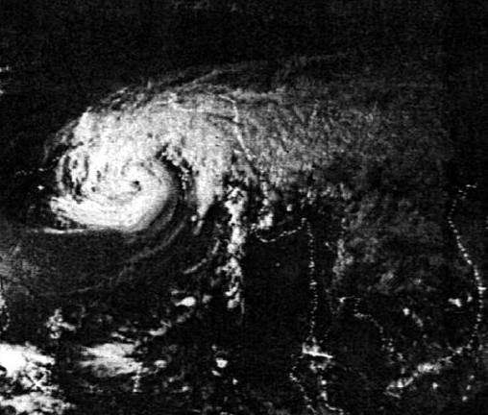
Countries with over 5000 deaths in a disaster compared with the GDP
1970 Bangladesh Cyclone
One of the deadliest natural disaster in human history.
Government was criticized for non-existent relief program.
Notes:
To answer this question, We took a deeper dive into the dataset and combined it with the country GDP dataset to answer this question
Every dot on the plot represents a major disaster that corresponds to a death toll and a GDP per capita value.
On the graph, we can clearly see an inverse relationship between GDP per capita and total deaths caused by each disaster.
We can thus conclude that populations in low-income countries are more vulnerable to the effects of natural disasters.

Slide 10
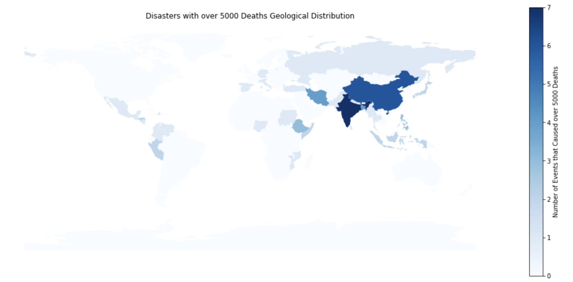
Most important culprit?
Most of them are densely populated countries
Notes:
The other major factor we observed is the population density of the country. From this graph, we can see that the countries which were more densely populated had more number of natural disaster events that caused more than 5000 deaths.

Slide 11
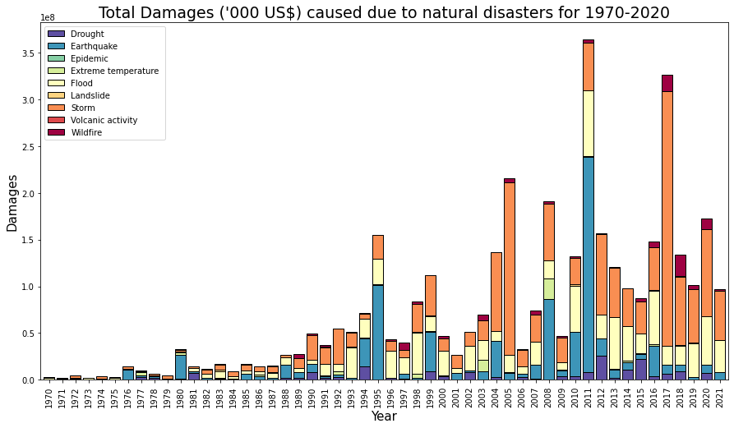
The damages were in general proportional to the occurrence of disasters
Notes:
This plot shows the damages incurred due to the disasters every year and we see that the damage is in proportion to the occurrence of the disasters

Slide 12
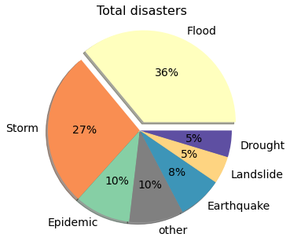
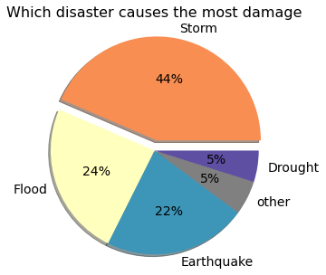
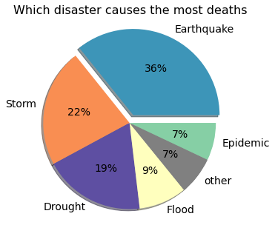
Disasters and their impact in the past 50 years.
Notes:
We tried to summarise all the trends into the pie charts. In the past 50 years while floods were the most frequently occurring disasters, storm created the most damage in terms of economic loss, and earthquake was responsible for most human loss.

Slide 13
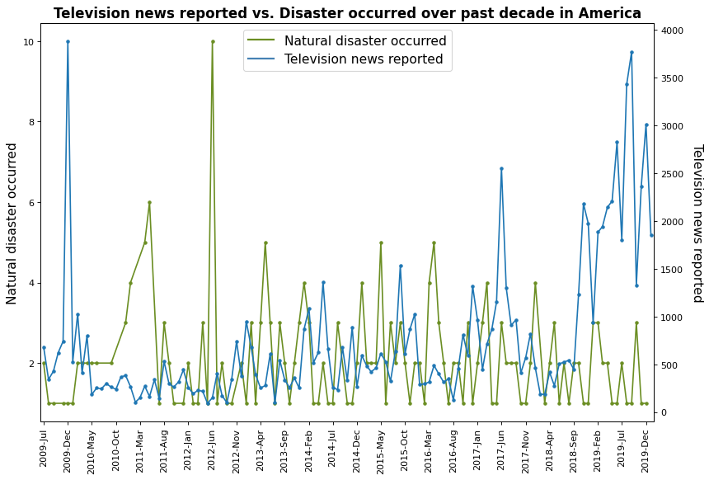
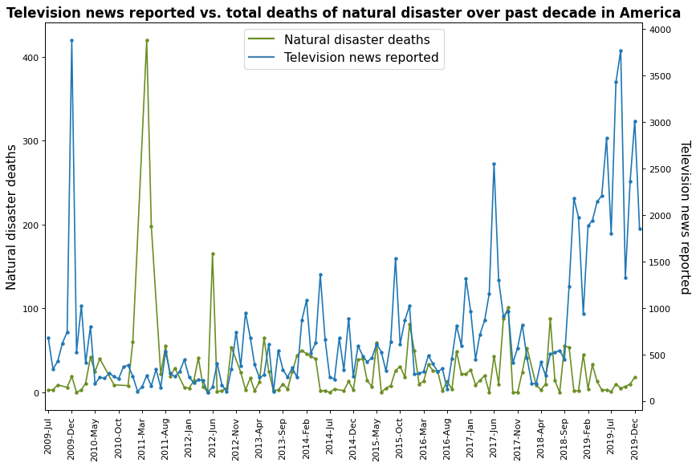
Correlation between Climate Change Television News and Natural Disaster in America
Examining the Climate Change Television News dataset to analyze the impact of natural disaster on public awareness of climate change
Disaster occurrences or its severity do not link to climate change awareness
Notes:
We then decided to explore if natural disaster can draw attention to the popular question of climate change. Intuitively, the rapid climate change for the past decade has always been related to the frequent occurrence of natural disasters. Therefore, we want to know if natural disasters can gather people’s attention on the topic of climate change in return.
We examined a television news dataset that covered all the news articles from popular news media on the topic of climate change from 2009 to 2019. We plotted the number of news articles along with the natural disaster statistics in time series. As the graph shows, the two lines don’t have any correlation and It turns out that the attention of climate change isn’t directly correlated to neither the disaster occurrences nor the number of deaths. This is opposite to what we have expected.

Slide 14

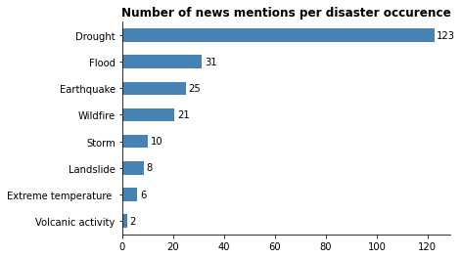
Which type of disaster invoked more climate change awareness?
Not all disaster types have the same effect on climate change awareness
For each occurrence of drought, there are on average 123 articles about climate change
Notes:
We then explored whether a particular type of natural disaster has more direct and effective impact on raising awareness on climate change. We extracted the number of mentions of natural disaster types from these news articles.
After plotting the result, we found out that some natural disasters are much more likely to be associated with climate change news than others. For example, for each time a drought occurs, there will be on average 123 climate change news articles mentions, while volcanic activity is hardly ever associated with climate change. This shows that different natural disasters have very different impact on raising climate change awareness.

Slide 15
Conclusion
Increase in the occurrence of natural disasters.
Decline in deaths from natural disasters over the past century.
Disasters affect those in poverty most heavily.
Different natural disasters have varying influences on drawing attention to climate changes.
Notes:
In conclusion, we can say that:
There has been an increase in the occurrence of natural disasters whereas the deaths from these natural disasters have seen a large decline.
Over the years, natural disasters occur more frequently but we are better at protecting us from disasters.
Disasters affect those in poverty most heavily: high death tolls tend to be centered in low-to-middle income countries
Different natural disasters have varying influences on drawing attention to climate changes.

Slide 16

Q&A
Notes:
Thank you for your attention. Any questions and comments?

